Slide 1
Welcome to St Cuthbert’s Nursery

Slide 2
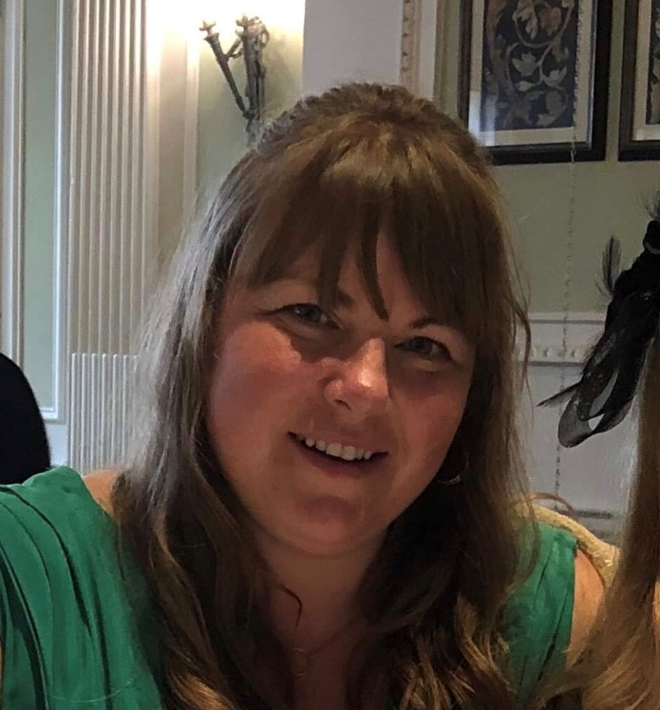
My name is Miss Graham and I am the Nursery Teacher.
Miss Green is the Teaching Assistant who works in Nursery.
We can’t wait to meet our new Nursery friends.

Slide 3
Nursery Pack
Nursery Booklet
PowerPoint Handout
The starting groups
Starting Timetable
Details of the school’s terms and holiday dates

Slide 4
How the Nursery Operates
There is a flexible drop off between 8:45am and 9:00am.
Full time children attend Nursery Monday to Friday 8:45-3:00- Blue group
Part time children attend Nursery for 15 hours on either:
Mon & Thurs 8:45-3:00pm & Wed 8:45-11:30am- Red group
Or
Tues and Fri 8:45-3:00pm and Wed 8:45-11:30am-Yellow Group
Have a few extra paid sessions available for £ 15 per session on the days your child does not attend Nursery. Please contact the office (£30 per day)

Slide 5
Intake Arrangements
Children who do not attend St Cuthbert’s Playgroup will receive an invitation to a ‘Stay and Play’ session. The child will attend this session with one of their parents/carers.
Children attending Playgroup will have transition sessions with Playgroup staff.
Build up of the Nursery groups for part time children and full time children who request it.
Please complete the parent survey to give us more information about your child.

Slide 6
Starting Timetable.
If we can help support you or your child with any issues you can see around the starting dates. Please speak to Miss Graham or ring the office.

Slide 7
The Nursery uniform consists of: Pale blue polo top Royal blue jumper or cardigan Grey joggers / trousers, grey skirt or grey pinafore dress Black, flat, velcro fastening shoes (so that they are easy to take on and off when we need to put our wellington boots on) Summer option: Blue gingham dress or grey shorts. School uniform can be bought at the ‘Tots To Teams’ uniform shop in Kingston Park (NE3 2EF) We do stock a small amount of uniform at school.

Slide 8
Safeguarding and parent tips
Inform Nursery staff if anyone else is picking up your child. Make sure they know the password.
Medicines to be administered at school must be prescribed to your child and forms signed.
Attendance-If your child can’t attend Nursery, parents must phone the school office.
No jewellery, earrings must be removed or taped over.
No mobile phones to be used in school.
Haircuts to be smart and appropriate for school. No elaborate hairbands or ‘extreme haircuts’ where the head is shaved to less than a grade 2.
Long hair to be tied back.
No nail vanish.

Slide 9
Learning Journeys.
Learning Journeys are emailed to parents on a half termly basis through Evidence Me. They show parents the activities their child has been participating in and the next steps in their learning. Parents are encouraged to email activities their child has been doing at home. School Website.
www.stcuthbertsk.newcastle.sch.uk The school website gives lots of information. The Early Years Section shows photographs split into terms & topics covered. It also has topic overviews that explain the activities & Early Years Outcomes statements Nursery plan to achieve. Newsletters, phonic guidance, policies and the EYFS Curriculum are all displayed for parents to read.

Slide 10
School Facebook Group.
Parents are invited to join the St Cuthbert’s Catholic Primary School Facebook group where photographs and descriptions of the children’s activities are posted. It is a closed Facebook group so only families that are connected to the school can view the posts. School also have a Twitter page that parents can access. Parents need to give permission for their child’s photographs to be used online by completing the ‘St Cuthbert’s Photograph Consent Form’.

Slide 11
How you can help your child
Talk positively to them about starting Nursery.
Encourage them to take their shoes and coats off by themselves.
Ensure they can go to the toilet independently & wash their hands.
Get them used to being with other children.
Provide Nursery staff with essential information that will help your child settle well into Nursery

Slide 12
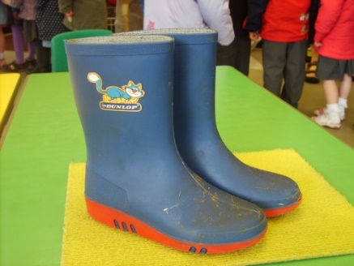
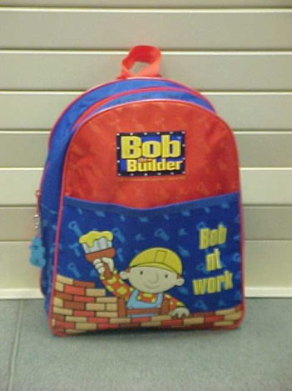
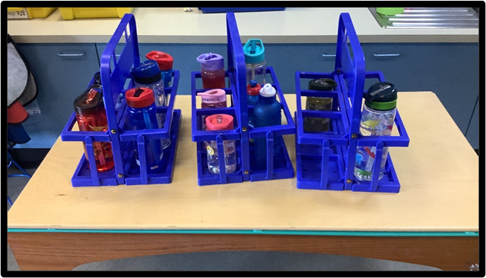
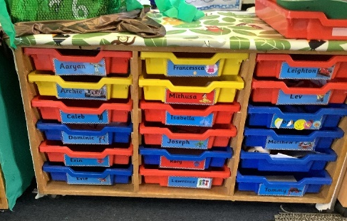
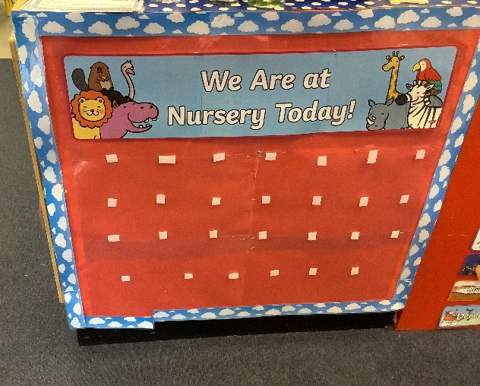
What your child needs
Wellingtons to be kept at Nursery
Spare clothes
Bag
Water bottle
Nursery Routine
Put their coat and bag on their peg.
Put their water bottle in the tray
Take their self registration photo from their draw
Put their photo on the ‘Who is in today’ display.
Help your child settle to an activity, then tell
them you are leaving

Slide 13
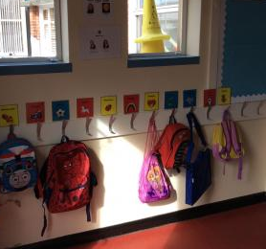
We have our own pegs where we hang our coats and bags. Wellington boots are kept on a trolley in the cloakroom.
Nursery Environment

Slide 14
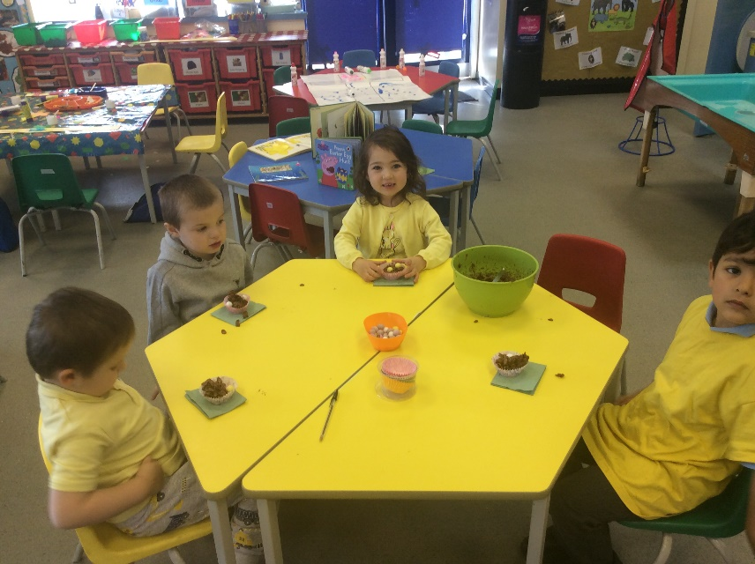
We know how important it is to drink water and eat fruit. We have a Snack Time where we can have a drink of water or milk and eat some delicious fruit. We take our water bottles home everyday so they can be cleaned and filled with fresh water.

Slide 15
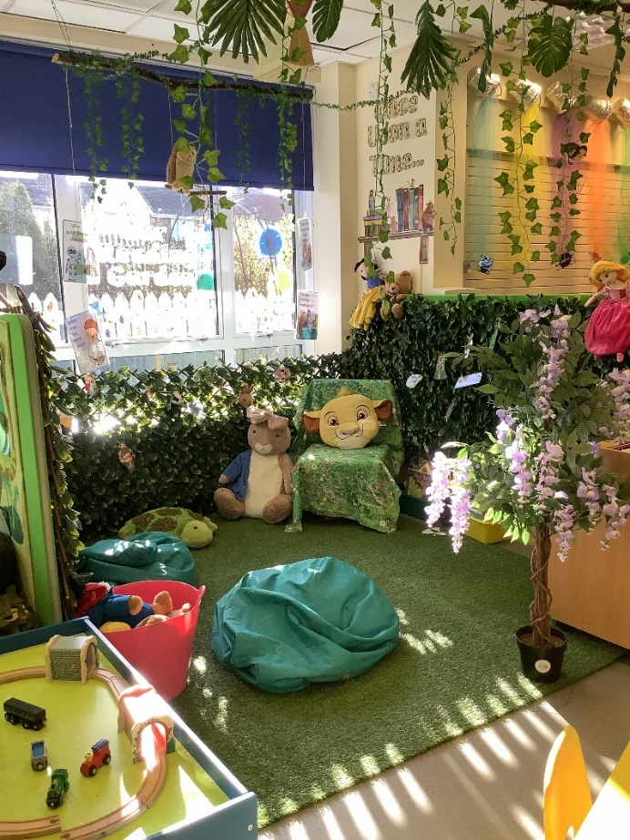
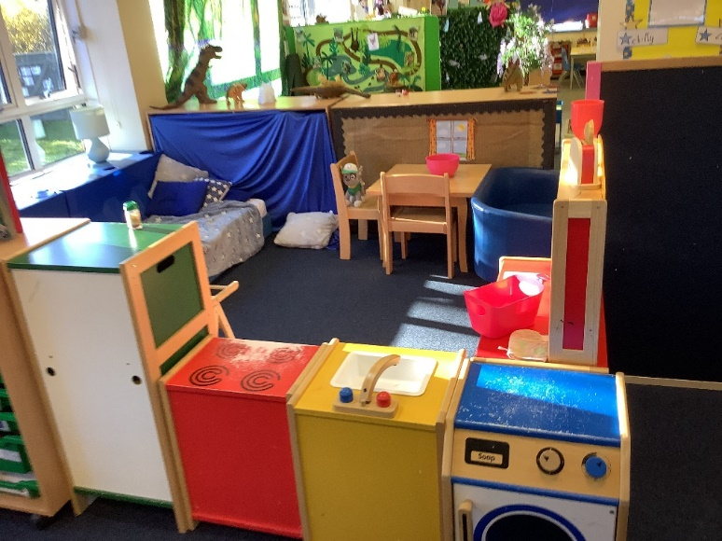
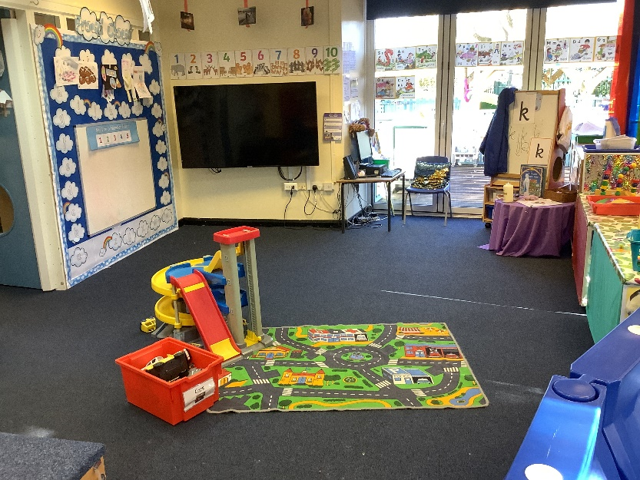
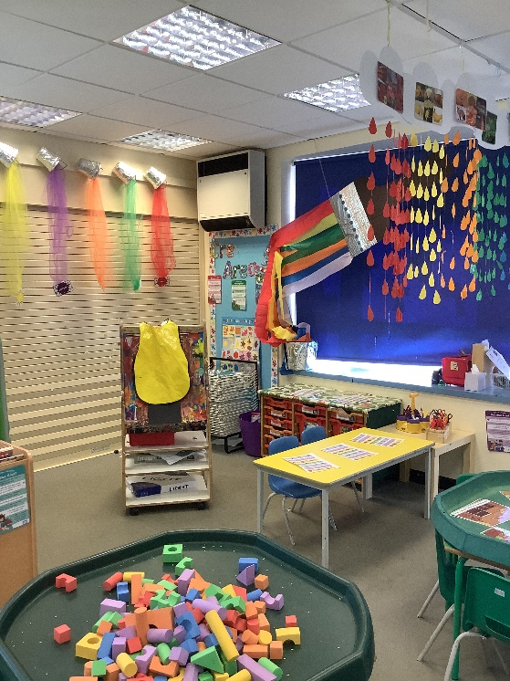
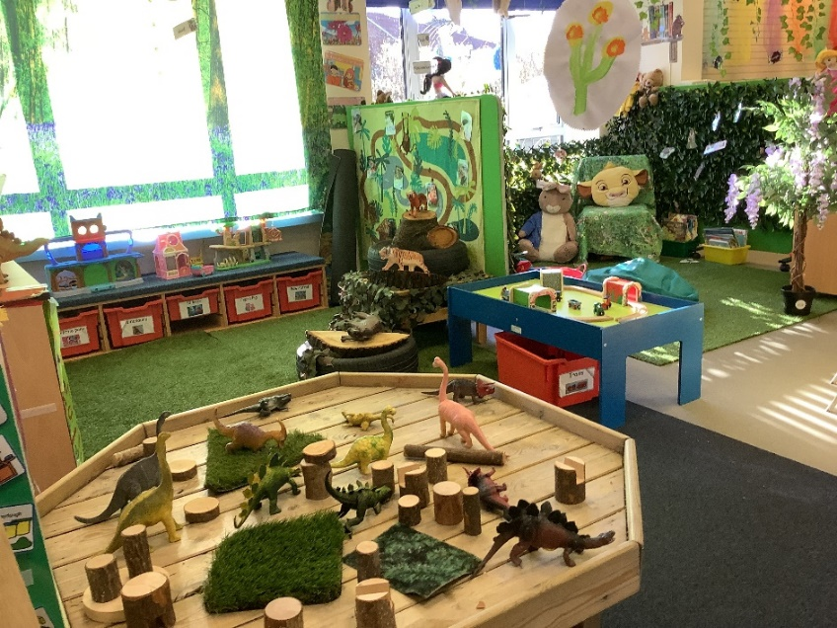
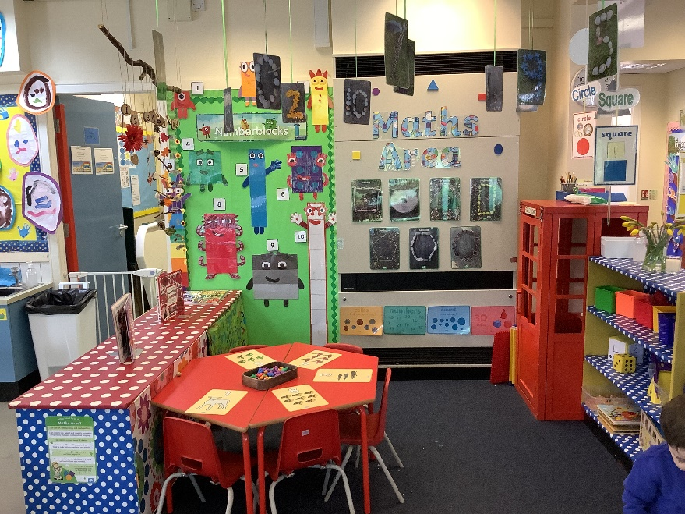
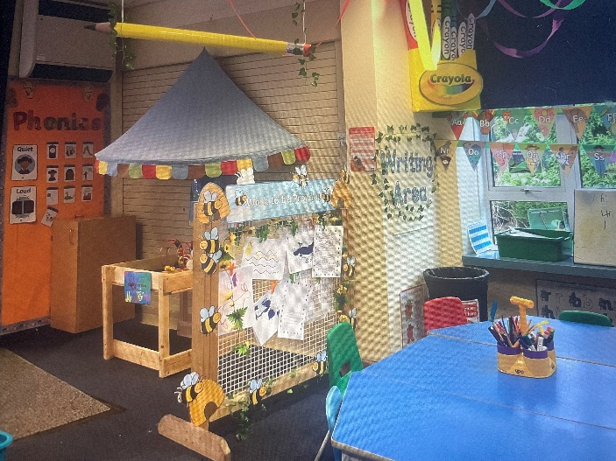
The children will love to explore the classroom and play with all the new toys.

Slide 16
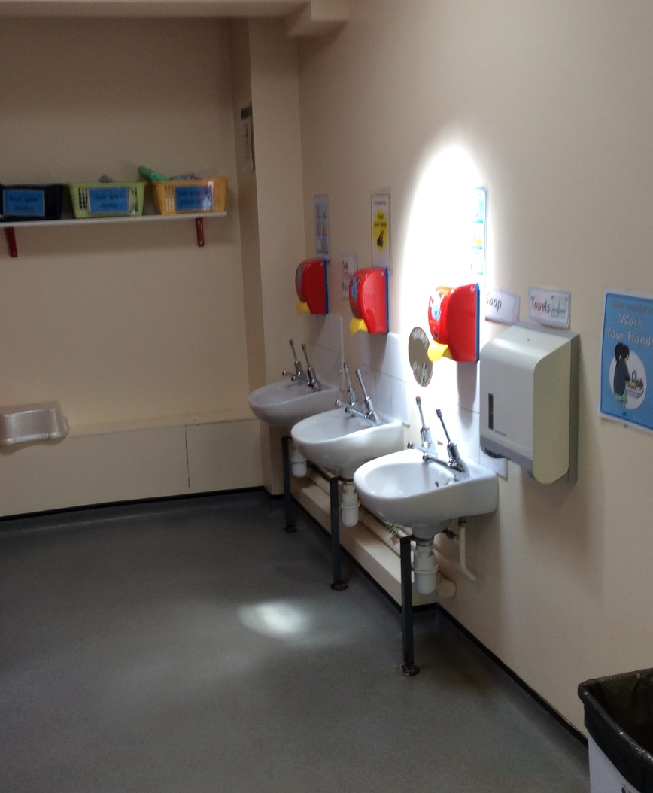
When we need the toilet, we can use it anytime as the toilets are in the classroom. When we have finished, we always wash our hands really well using the squirty soap.

Slide 17
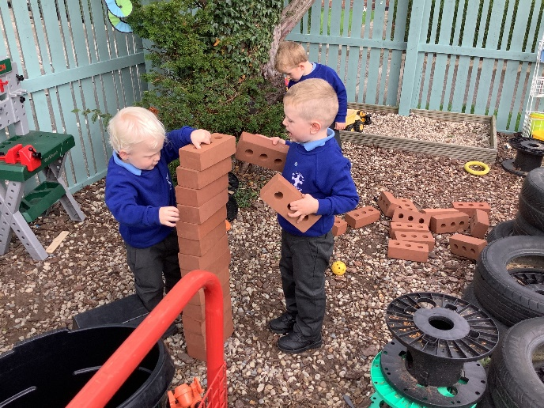
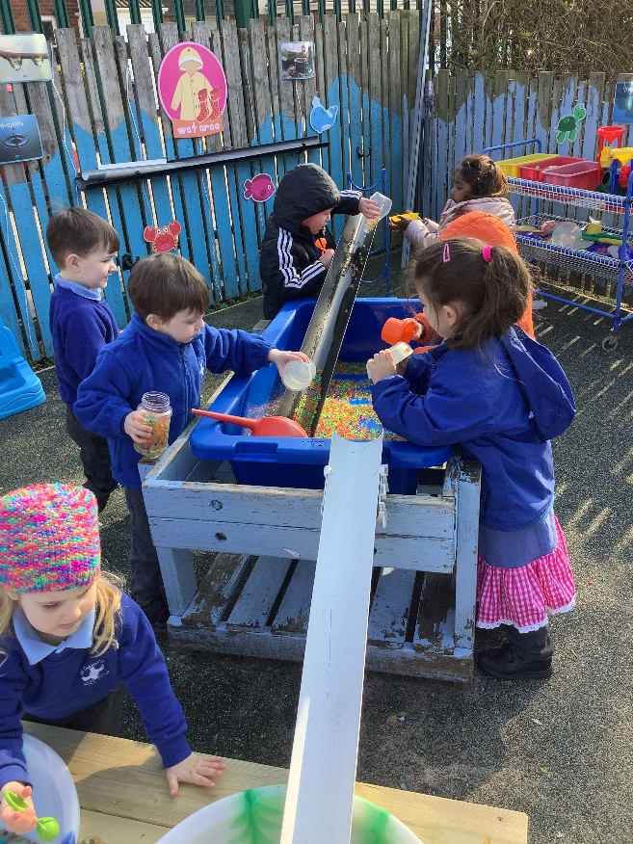
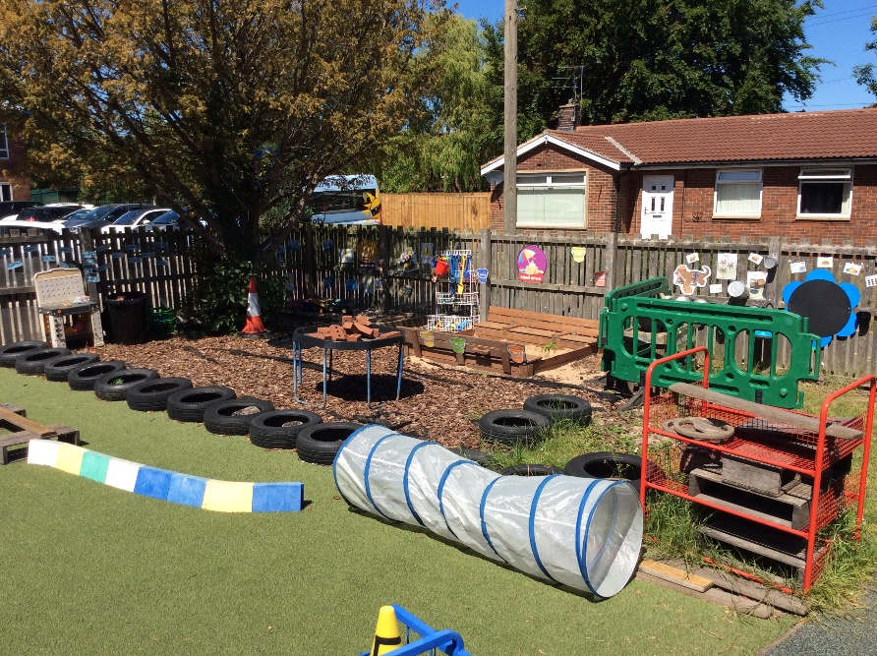
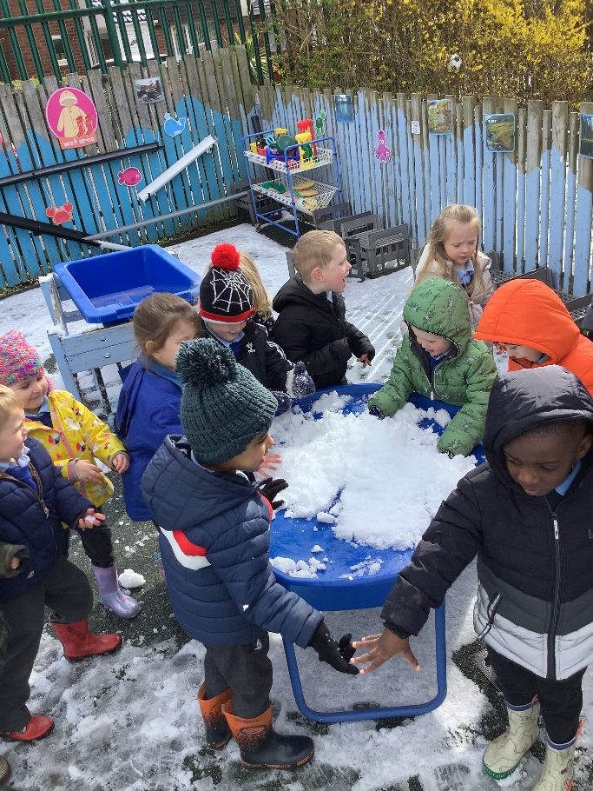
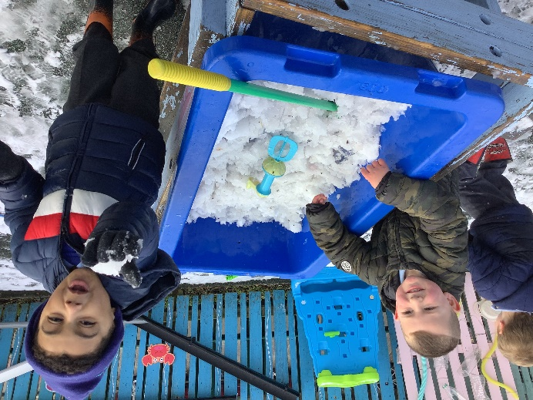
We love to spend lots of time in the Rainbow Garden, whatever the weather. There is so much to do!

Slide 18
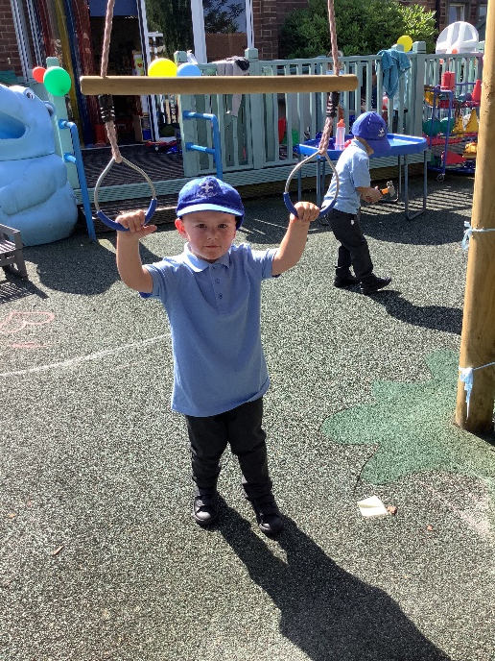
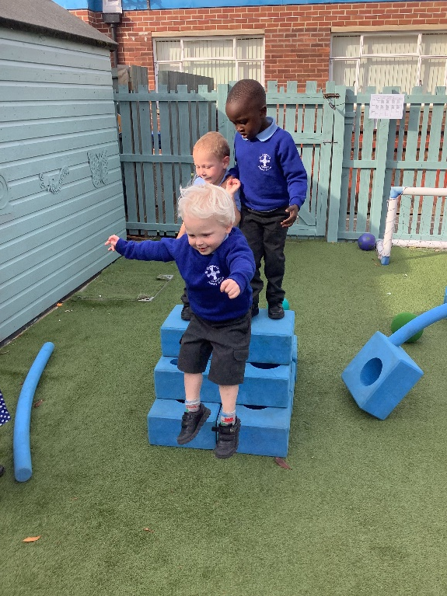
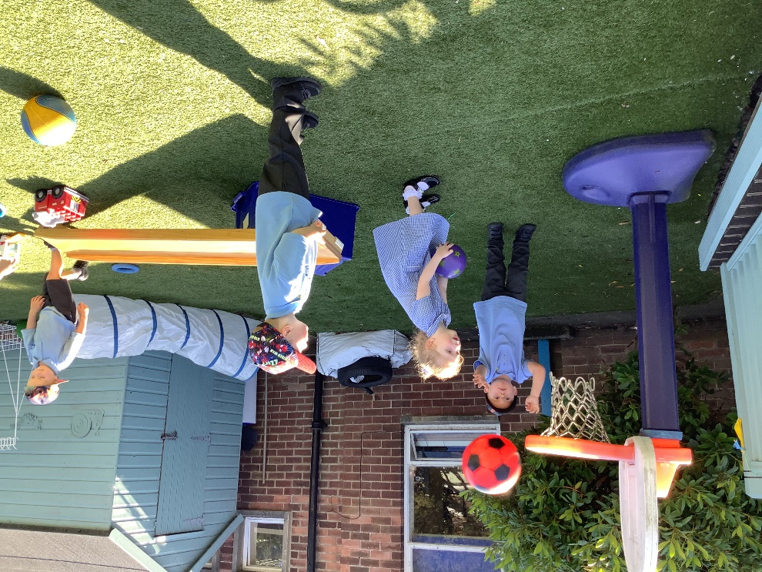
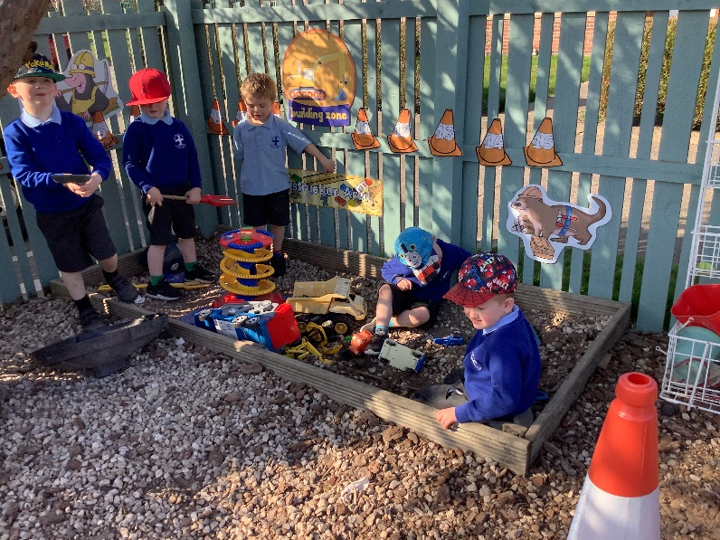
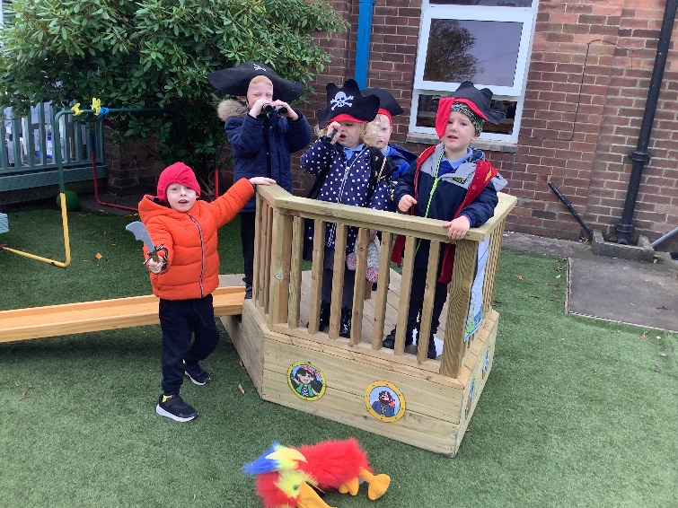
We keep active outside playing with the footballs, bats and balls and crawling through tunnels but also like some quiet time in the covered outdoor reading & mark making area.

Slide 19
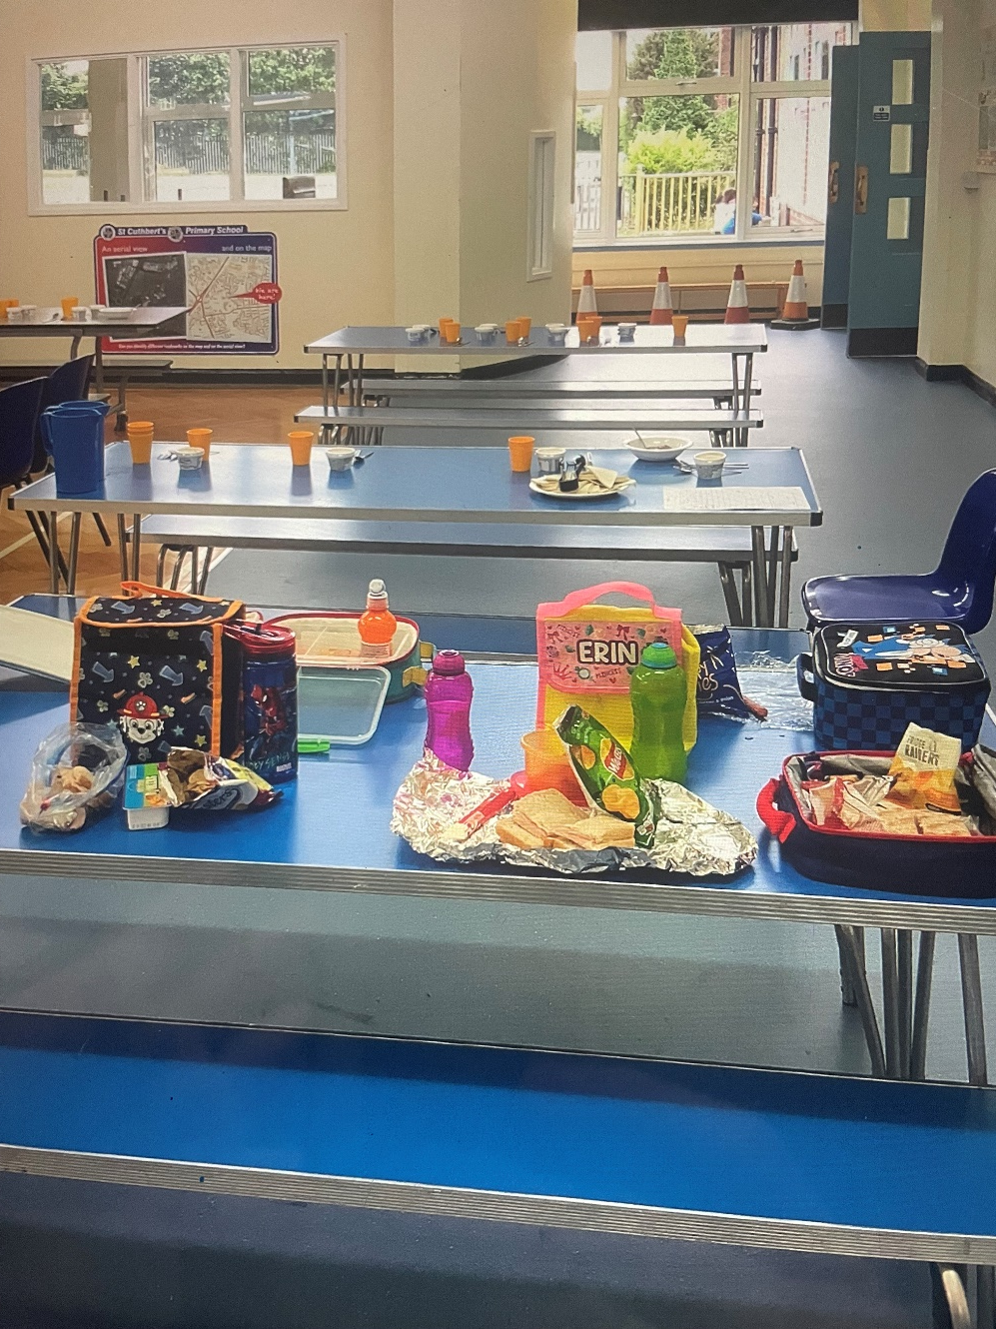
Lunchtimes
We eat lunch in Nursery at 11:30.
We have lunch in the KS1 Hall where we sit with our friends with the dinner lady.
Children can pay for a school meal (£2.10 per day) or bring a packed lunch.
School meals often encourage children to try new food.
Choice of 3 school meals which you select from in advance.
However children can bring in their own Healthy packed lunch if they would prefer.

Slide 20
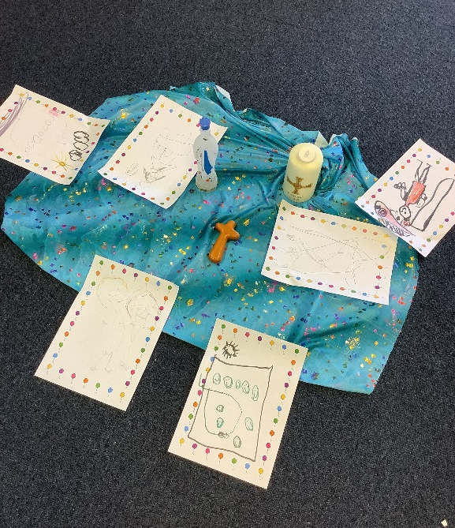
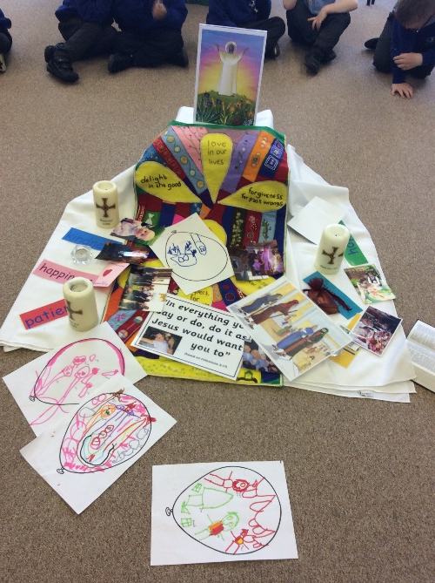
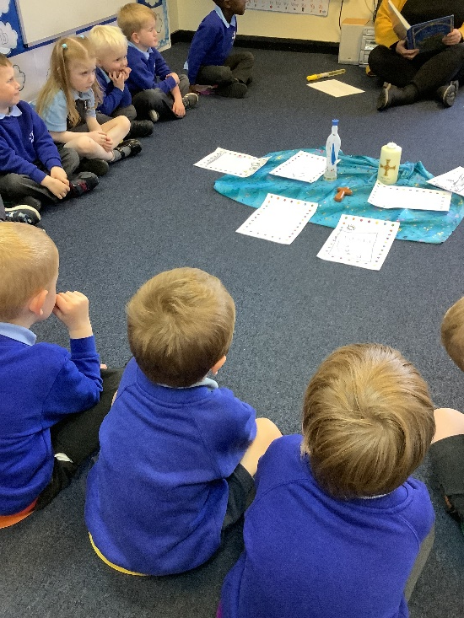
We have RE lessons each week based on a theme. Often, we visit the school chapel for our class liturgies. We share prayer time when we start school, before we have our lunch and at the end the day.
RE.

